Slide 1
Osher Lifelong Learning Institute, Fall 2023
Contemporary Economic Policy
Eckerd College
Fall, 2023
Jon Haveman, Ph.D.
National Economic Education Delegation

Slide 2
Course Outline
Contemporary Economic Policy
  Week 1 (10/10): Economic Update (Geoffrey Woglom Amherst College)
  Week 2 (10/17): International Institutions (Alan Deardorff U of Michigan)
  Week 3 (10/24): Economics of Immigration (Roger White Whittier College)
  Week 4 (10/31): Trade and Globalization (Avik Chakrabarti U Wisconsin Milwaukee))
  Week 5 (11/07): Economic Inequality (Roger White Whittier College)
  Week 6 (11/10): Federal Debt (Brian Peterson Lagrange College)

Slide 3
International Economic Institutions
Alan V. Deardorff
University of Michigan
Presentation to Eckerd College
October 17, 2023

Slide 4
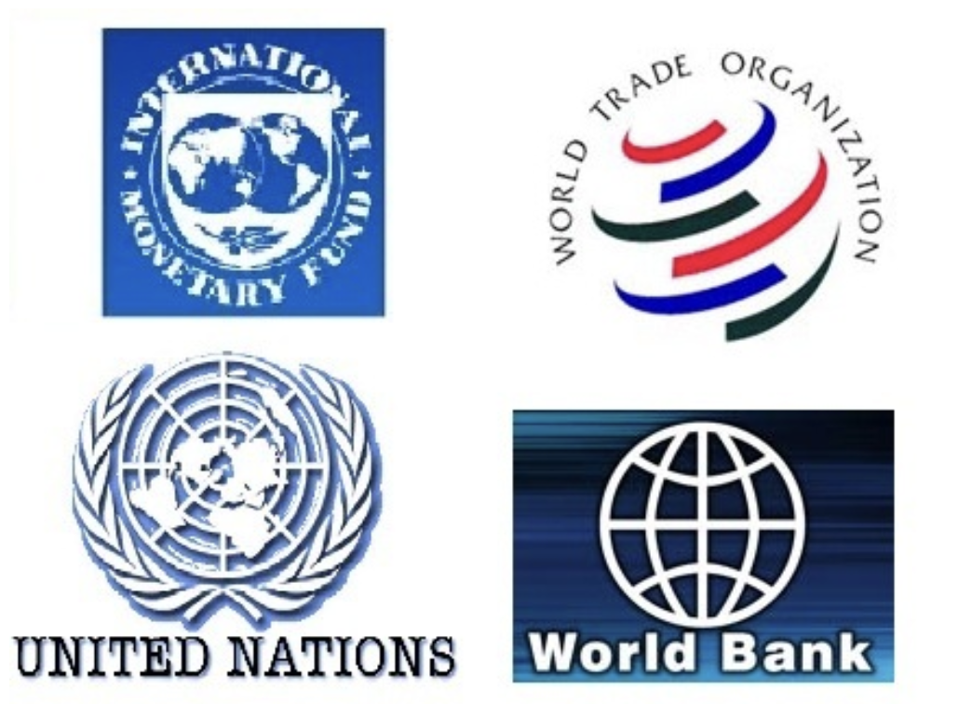
Main Economic Institutions
Notes:
https://sbhshgovapmacro.wordpress.com/2011/06/02/international-institutions/

Slide 5
Views
Economists like myself tend to view all these institutions as
  Valuable, but
  Flawed
But the public, and specialists in things other than economics, often see them as
  Ineffective
  Harmful
Examples…

Slide 6
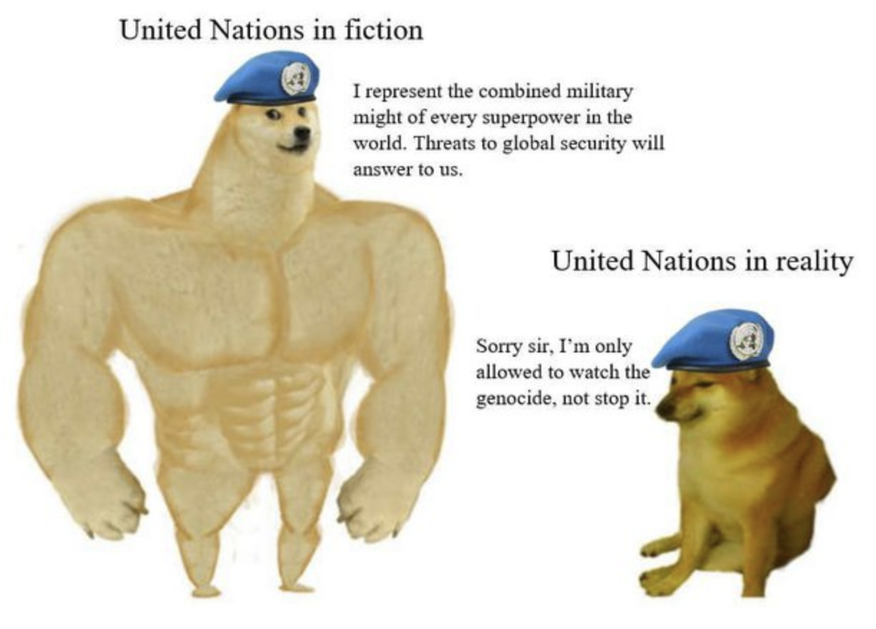
UN
Notes:
https://www.quora.com/When-has-the-United-Nations-been-less-than-effective

Slide 7

UN
Notes:
https://www.nytimes.com/2016/03/20/opinion/sunday/i-love-the-un-but-it-is-failing.html

Slide 8
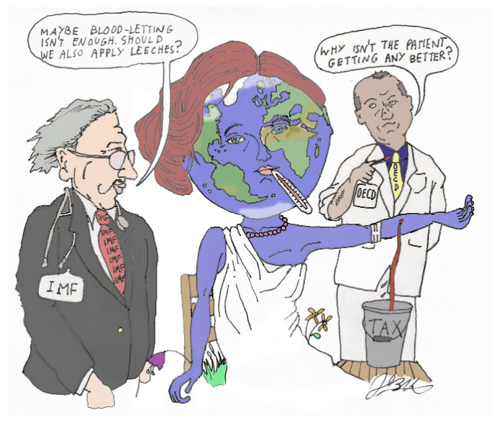
IMF
Notes:
https://www.cato.org/blog/international-monetary-fund-accidentally-provides-strong-evidence-laffer-curve

Slide 9
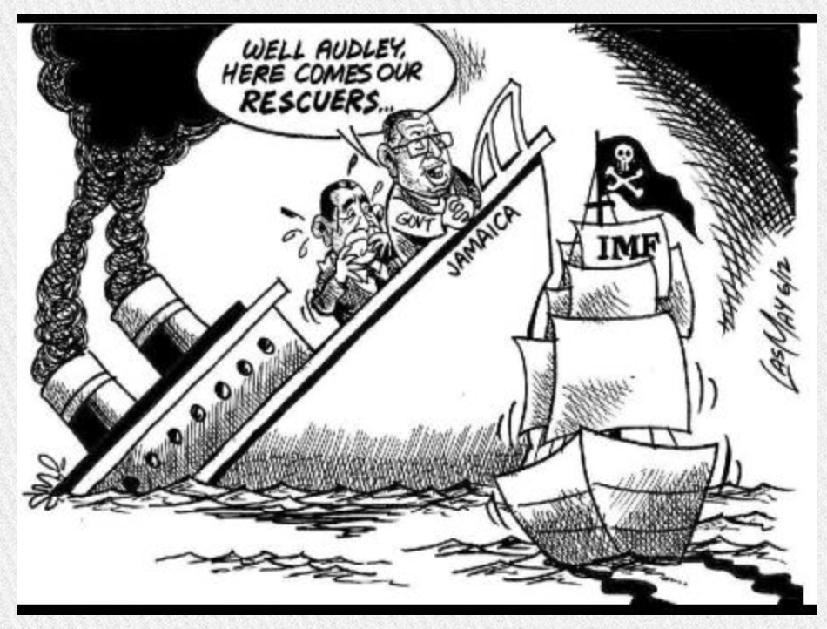
IMF
Notes:
https://jamaica-gleaner.com/gleaner/20120930/focus/focus1.html

Slide 10
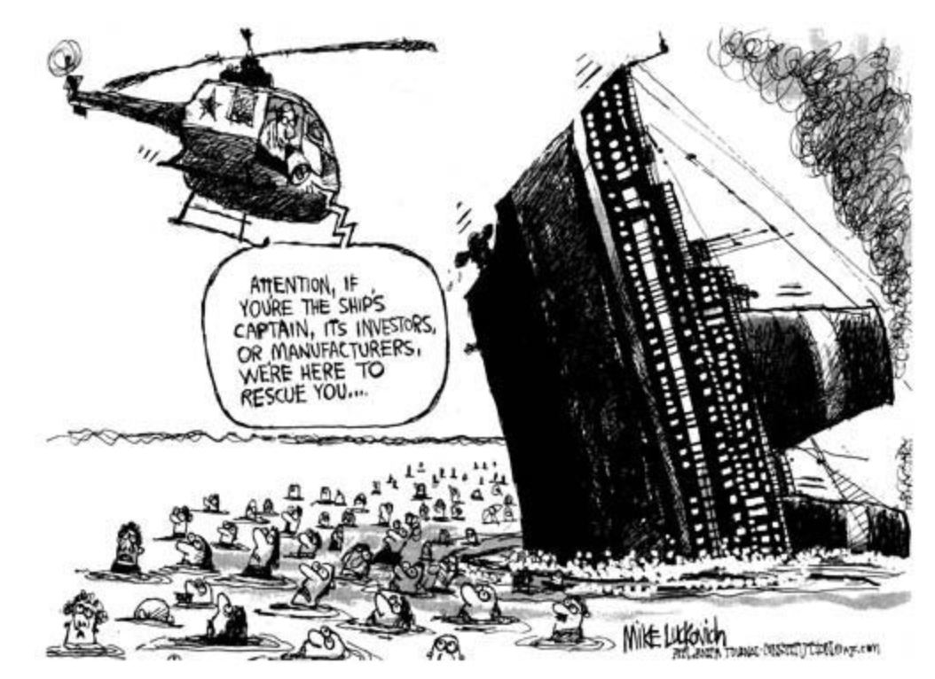
IMF
Notes:
https://www.pbp.ie/eu-imf-shock-therapy-will-make-a-bad-situation-worse-remove-last-semblance-of-democracy/

Slide 11
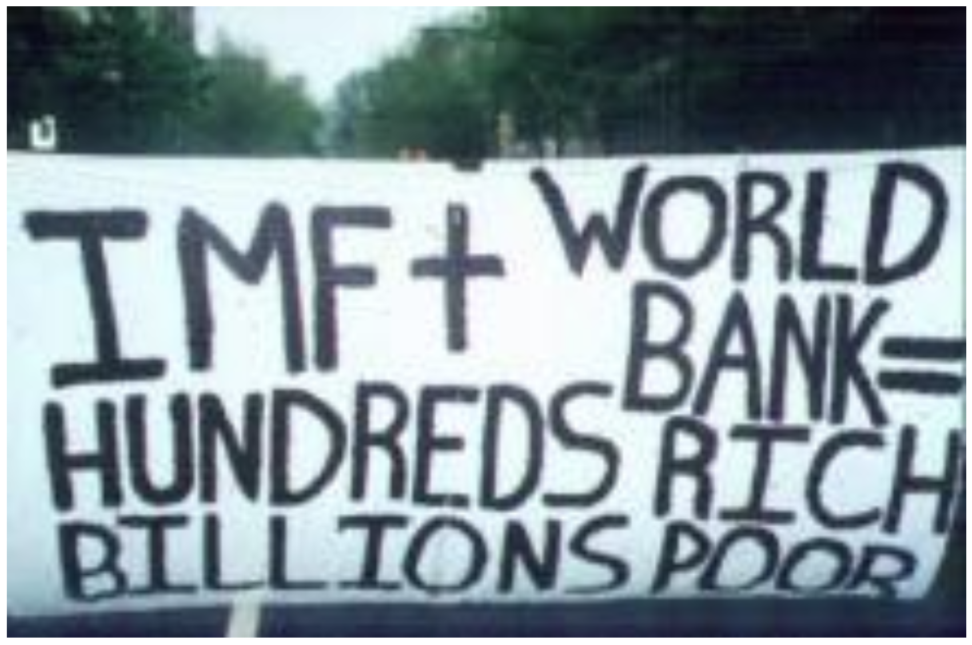
IMF & World Bank
Notes:
https://libcom.org/article/more-bad-news-world-bank

Slide 12
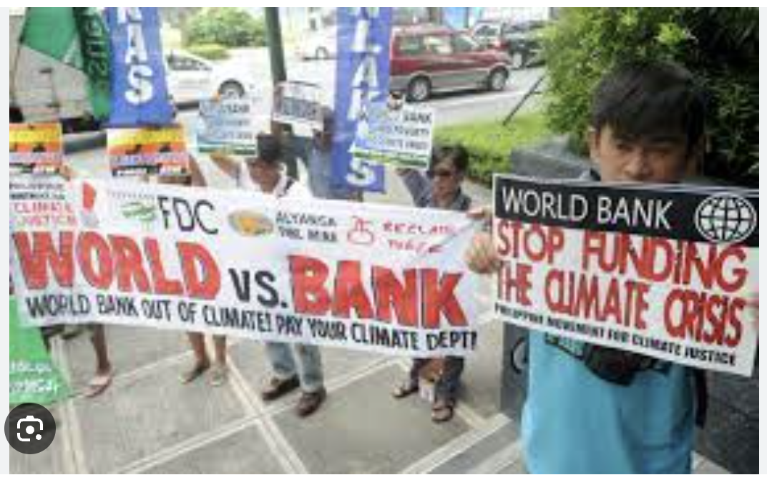
World Bank
Notes:
http://america.aljazeera.com/opinions/2015/7/the-world-bank-has-an-accountability-problem.html

Slide 13
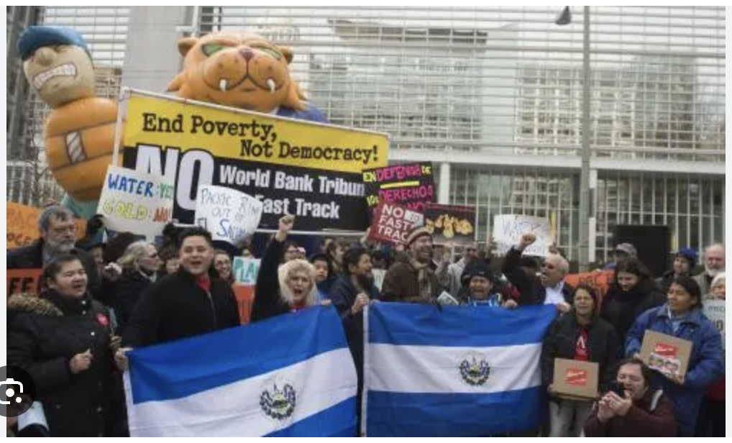
World Bank
Notes:
https://www.google.com/search?q=world+bank+bad&tbm=isch&ved=2ahUKEwj_56CJxL6BAxUIJtAFHWb2DkgQ2-cCegQIABAA&oq=world+bank+bad&gs_lcp=CgNpbWcQAzIHCAAQGBCABDoFCAAQgAQ6BggAEAcQHjoICAAQCBAHEB5QvghY7jhgmUdoAHAAeACAAX6IAZ4IkgEDOC4zmAEAoAEBqgELZ3dzLXdpei1pbWfAAQE&sclient=img&ei=g7INZb-aI4jMwN4P5uy7wAQ&bih=652&biw=1398&rlz=1C5GCEM_enUS993US993#imgrc=b0LR28pjgCP12M

Slide 14
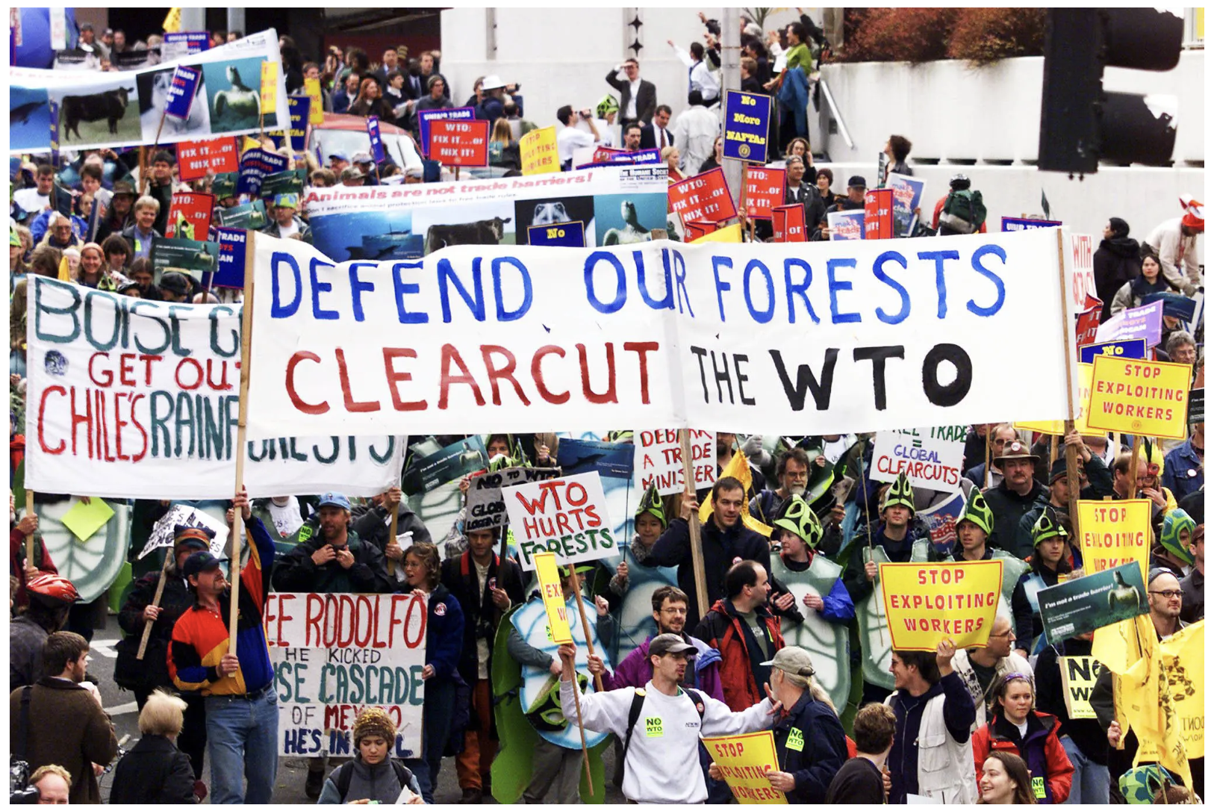
WTO
Notes:
https://www.nytimes.com/2019/11/28/opinion/seattle-world-trade-organization.html

Slide 15
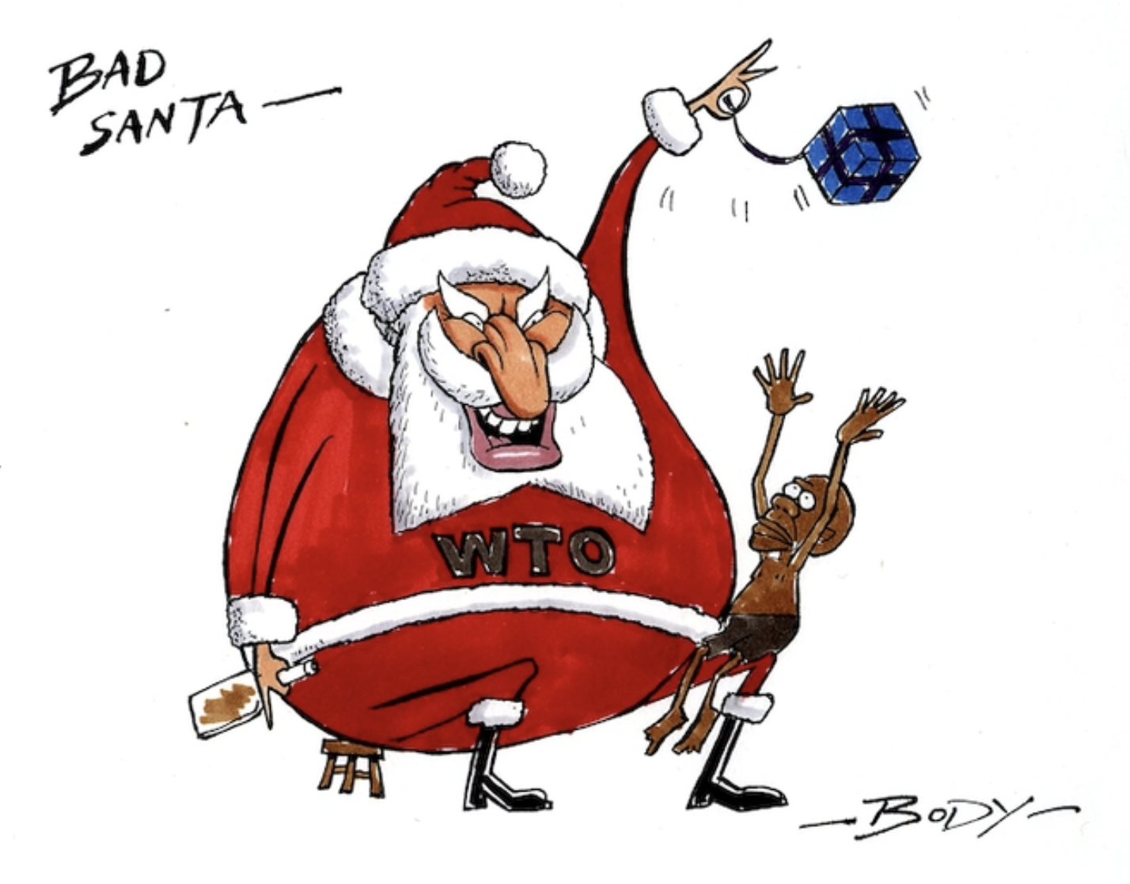
WTO
Notes:
https://natlib.govt.nz/records/23054047?search%5Bi%5D%5Bsubject_authority_id%5D=-64352&search%5Bpath%5D=items

Slide 16
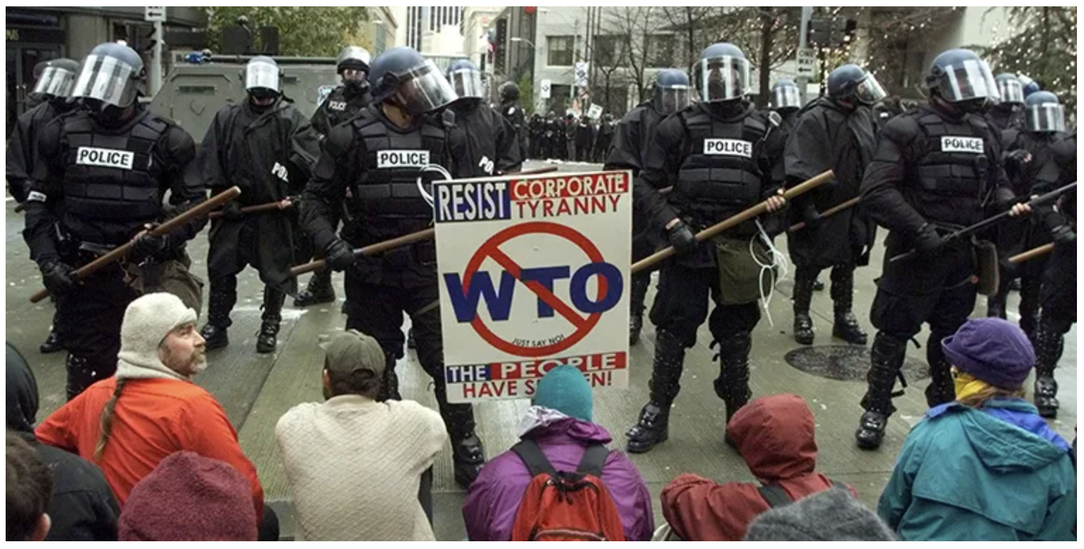
WTO
Notes:
https://world101.cfr.org/understanding-international-system/global-governance/what-world-trade-organization

Slide 17
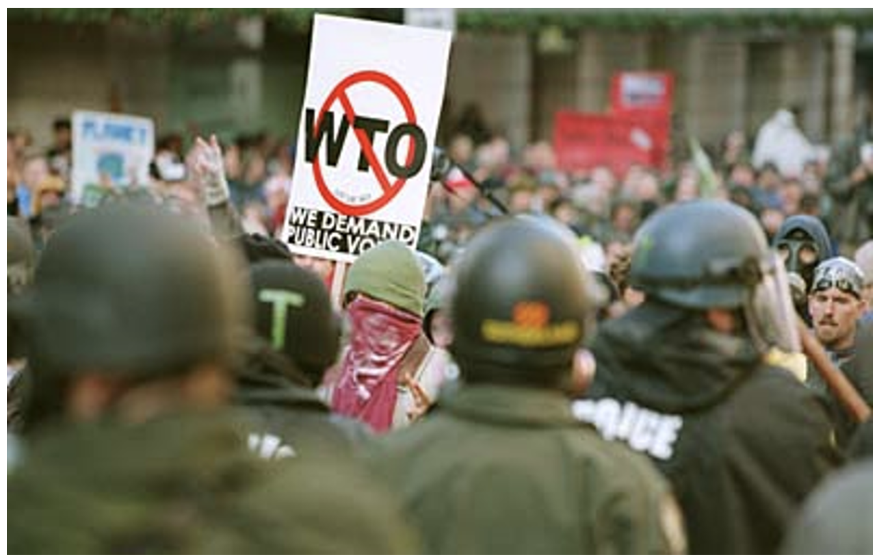
WTO
Notes:
From course slides. Don’t know where i

Slide 18
Outline
The Four Main Institutions
  Compared
  Individually
    United Nations
    International Monetary Fund
    World Bank
    World Trade Organization
Other Institutions
Economic Groupings of Countries
  Free Trade Agreements and Customs Unions
  Other

Slide 19
Institutions Compared
Major Economic Institutions Compared
 | Members | Budget $ mil |  | Employees |  | from Countries
UN | 193 | 3,400 |  | 125,436
IMF | 190 | 1,411 |  | 2,400 |  | Over 190
World Bank | 189 | 2,851 |  | 18,946 |  | Over 170
WTO | 164 | 217 |  | Over 600 |  | Around 80

Slide 20

United Nations

Slide 21
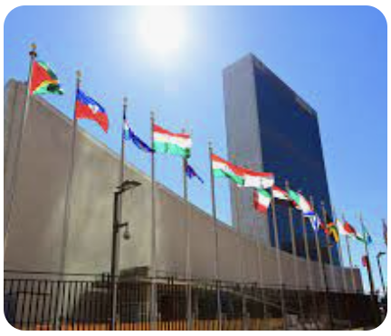
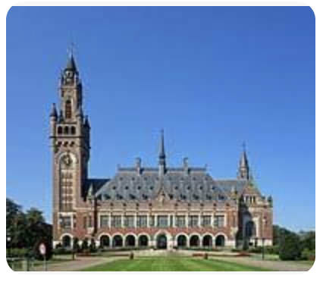
United Nations
United Nations
  Created after World War II (replacing League of Nations from post-WWI)
  Major organs:
    General Assembly
    Security Council
    Economic and Social Council
    Trusteeship Council
    Secretariat
    International Court of Justice, The Hague, Netherlands.
  Also has many other organizations affiliated with it, some of which existed prior to the UN
Based at UN Headquarters in New York

Slide 22
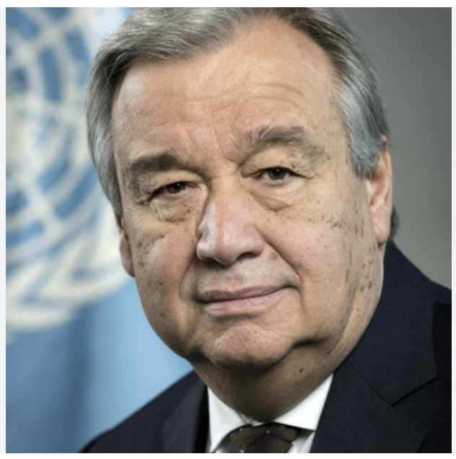
United Nations
Director General: António Manuel de Oliveira Guterres
  Portuguese
  Was Prime Minister of Portugal 1995-2002

Slide 23
United Nations
Security Council has the power
  15 members, each with one vote
    5 Permanent members, each with veto
      China, France, Russia, UK, US
    10 elected members with 2-year terms (ending date)
      (2023) Albania, Brazil, Gabon, Ghana, UAE
      (2024) Ecuador, Japan, Malta, Mozambique, Switzerland
  Presidency cycles through members each month (Oct 2023 is Brazil)
  All 193 UN members ”are obligated to comply with Council decisions.”
General Assembly votes to express opinions but has no power
Notes:
https://www.un.org/securitycouncil/content/security-council-members
https://www.un.org/securitycouncil/content/presidency

Slide 24
United Nations
Major UN Organizations are
  UNICEF = United Nations Children's Fund
    (Originally United Nations International Children's Emergency Fund)
    Humanitarian and developmental aid to children
  UNHCR = United Nations High Commissioner for Refugees
    Aids and protects refugees
  WFP = World Food Programme
    Provides food assistance worldwide
  WHO = World Health Organization
    Responsible for international public health
  UNDP = United Nations Development Programme
    Helps countries eliminate poverty and achieve sustainable economic growth and human development.

Slide 25
United Nations
UN Economic Organizations are
  ILO = International Labour Organization
    Founded 1919 under League of Nations
    Sets international labor standards
    Has no enforcement power
  WIPO = World Intellectual Property Organization
    Founded 1967
    Forum for intellectual property policy
      patents, trademarks, copyrights, etc.
    Has no enforcement power

Slide 26
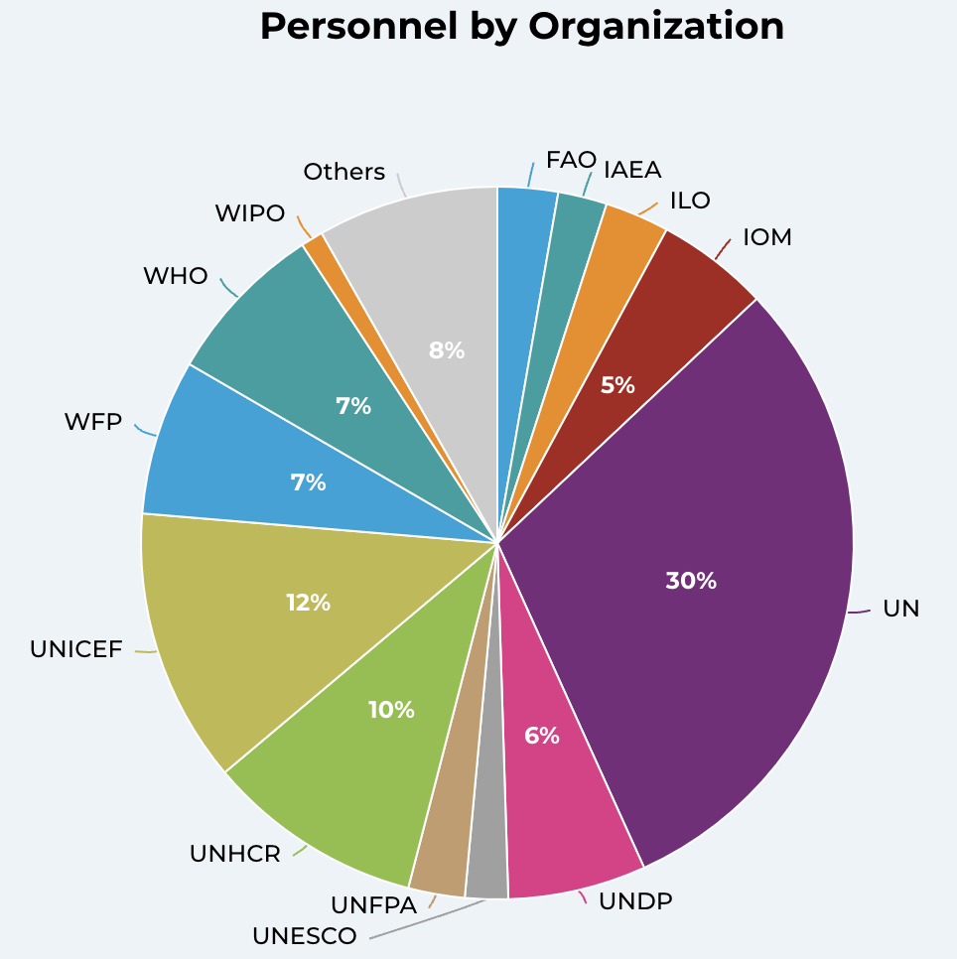
UN Personnel
Notes:
https://unsceb.org/hr-organization

Slide 27
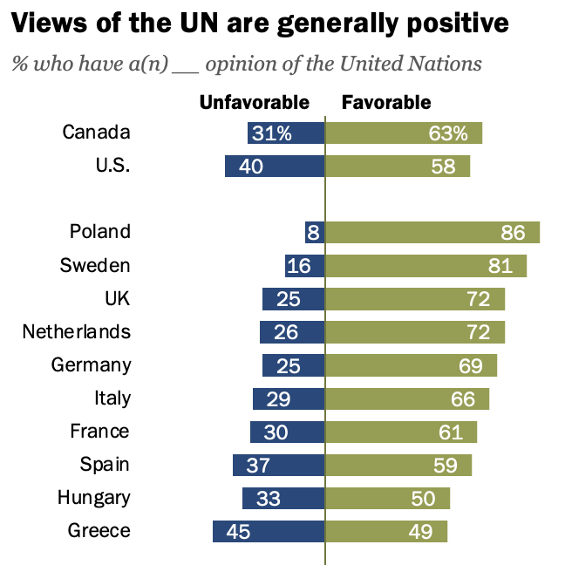
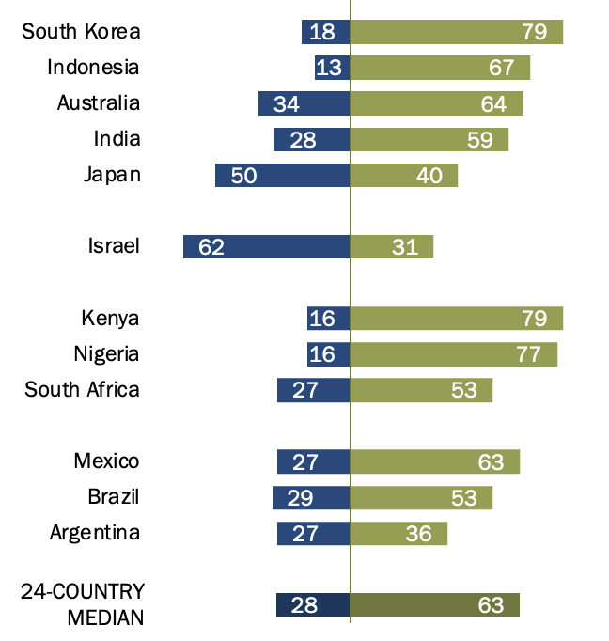
UN Views
Source: Pew Research Center, Aug 31, 2023
Notes:
Fagan, Moira, “People across 24 countries continue to view UN favorably,” Pew Research Center, August 31, 2023.
https://www.pewresearch.org/short-reads/2023/08/31/people-across-24-countries-continue-to-view-un-favorably/

Slide 28
UN Budget
UN has two budgets, plus voluntary contributions
  Regular budget
    Country contributions based on “capacity to pay”
      Decided every three years
      Formula uses shares of gross national income with adjustments for debt, population, and level of development
  Peacekeeping budget
    Decided by Permanent Members of Security Council
    Contributions from same formula, with additional adjustment for
      Contributing troops
  Voluntary contributions
    Fund a large part of disaster relief, development work and agencies such as UNICEF.
Notes:
https://betterworldcampaign.org/us-funding-for-the-un/un-budget-formula#:~:text=There%20are%20two%20main%20budgets,of%20global%20gross%20national%20income.

Slide 29
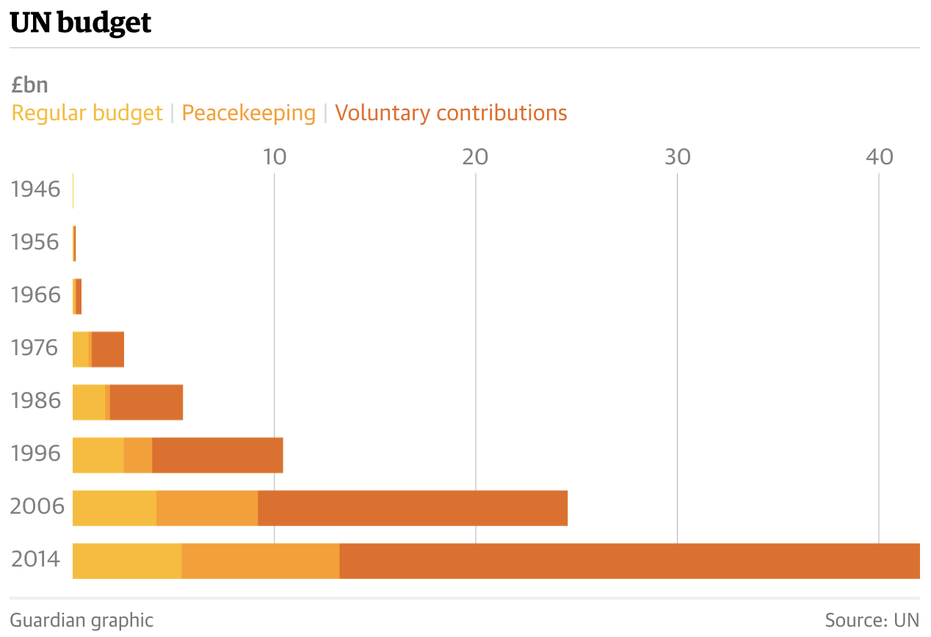
UN Budget
(Apparently in 2015 currency)
Looks big. But “still only about half of New York City’s $75bn budget.”
Source: Reed, “70 years and half a trillion dollars later: what has the UN achieved?” The Guardian, 2015.
Notes:
https://www.theguardian.com/world/2015/sep/07/what-has-the-un-achieved-united-nations
These data seem to be adjusted for inflations, as article says “Even accounting for inflation, annual UN expenditure is 40 times higher than it was in the early 1950s.”

Slide 30
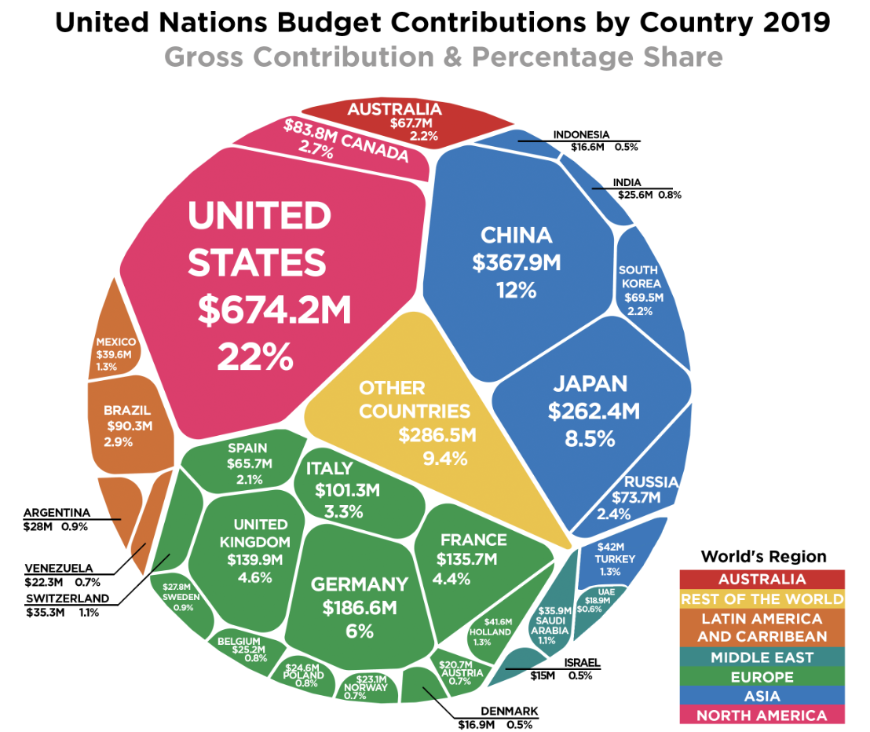
UN Budget
Notes:
https://howmuch.net/articles/united-nations-budget-contributions-by-country-2019

Slide 31

IMF

Slide 32
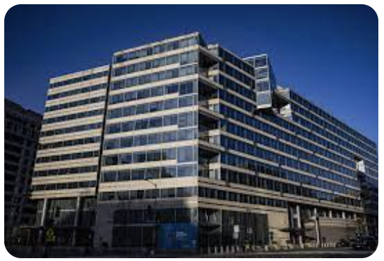
IMF
International Monetary Fund
  Created at Bretton Woods 1944
  Headquarters in Washington, DC
  Original purpose
    To prevent international financial crises by
      Overseeing exchange rates pegged to the US dollar
      Providing resources to central banks to assist in exchange-rate management
  Current purpose
      (Since major countries no longer have pegged exchange rates)
    “Promote financial stability and monetary cooperation”
    “Lender of last resort and global standard-setter”
Notes:
https://www.ft.com/content/ab44dccf-e613-485d-a901-2b19badc9705

Slide 33
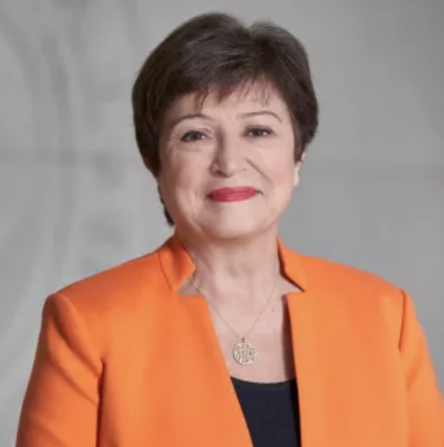
IMF
Managing Director: Kristalina Georgieva
  Bulgarian economist

Slide 34
IMF
Things the IMF does
  Policy advice
  Loans to countries in financial distress
    Conditional on agreeing to “undertake certain policy actions” (“Policy conditionality”)
      Ceilings on external debt, government wage bill
      Improve tax administration, fiscal transparency, anti-corruption
    Charges interest rate based on the SDR interest rate (see below) plus a margin that is currently 100 basis points (one percentage point)
  Capacity development assistance and training
Notes:
https://www.imf.org/en/About

Slide 35
Aside on SDRs
SDR = “Special Drawing Rights”
  History is interesting but not important
  A sort-of international money
    Created by IMF
    Used only by central banks with each other
  Value is a basket of major currencies, used for IMF bookkeeping and transactions
    Dollar, euro, renminbi, yen, pound
  Interest rate is posted by IMF each week based on interest rates in component currencies
Notes:
https://www.imf.org/external/np/fin/data/sdr_ir.aspx

Slide 36
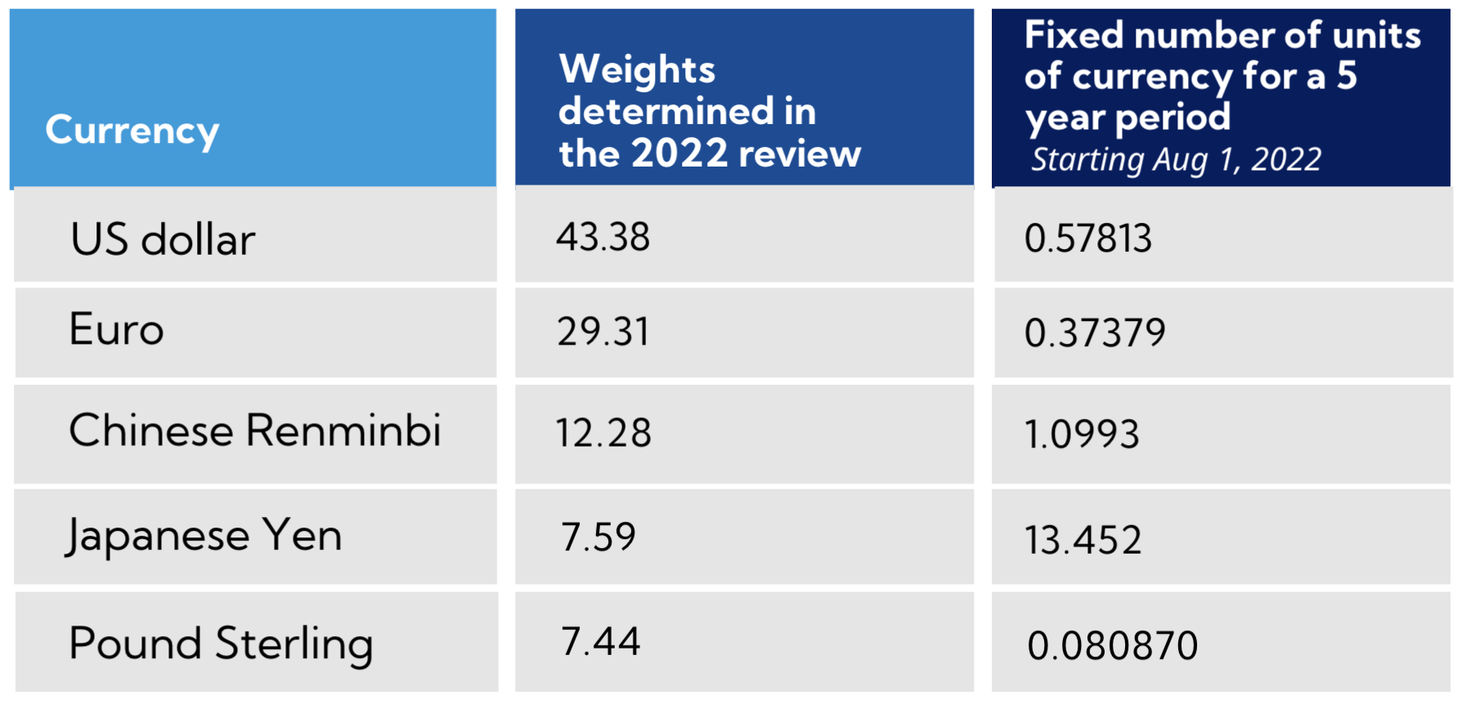
Aside on SDRs
Notes:
https://www.imf.org/external/np/fin/data/sdr_ir.aspx

Slide 37
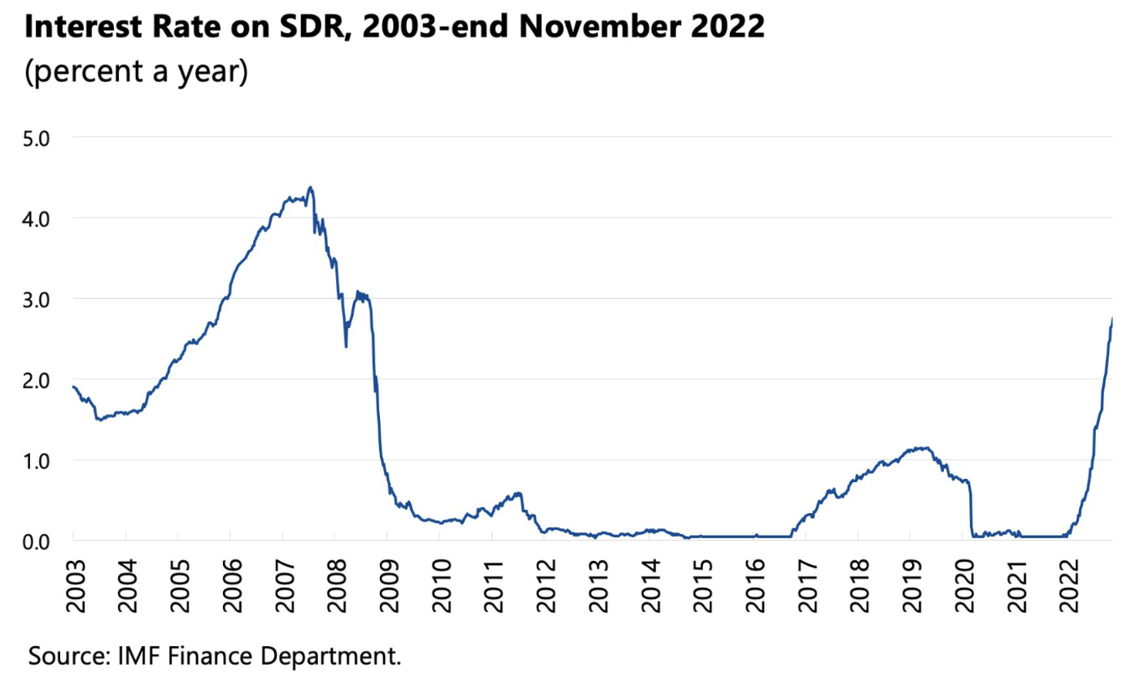
Aside on SDRs
Notes:
https://www.imf.org/external/np/fin/data/sdr_ir.aspx

Slide 38
IMF Funding
IMF Funding comes from 3 courses
  Member quotas
    Assigned based “broadly on its relative position in the world economy”
    Reviewed every 3 years
    Last increased 2010 for effect 2016
    Current review due mid-December 2023
  New Arrangements to Borrow
  Bilateral Borrowing Agreements
Notes:
https://www.imf.org/en/About/Factsheets/Where-the-IMF-Gets-Its-Money

Slide 39
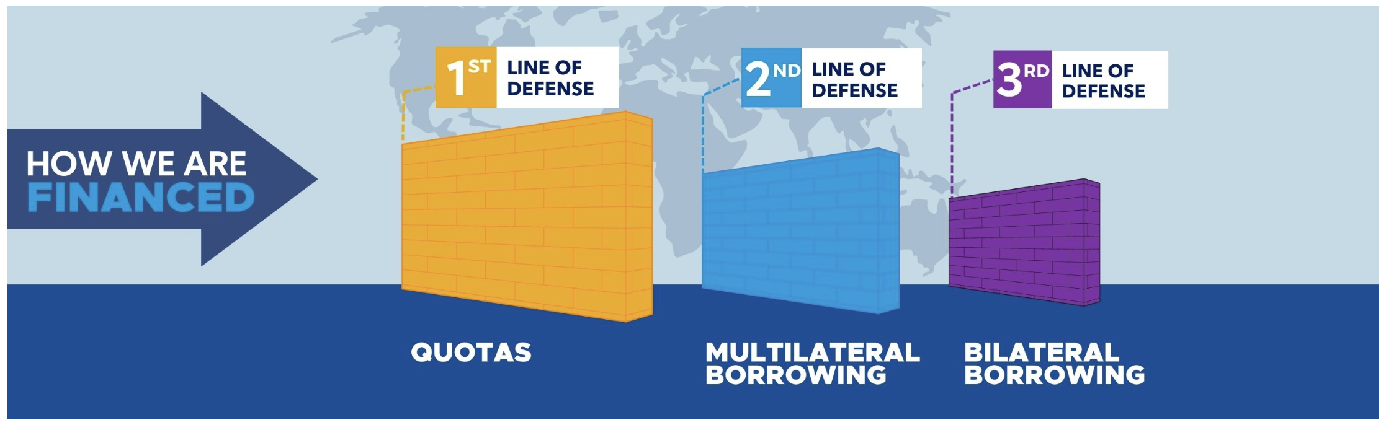
IMF Funding
Notes:
https://www.imf.org/en/About/Factsheets/Where-the-IMF-Gets-Its-Money

Slide 40
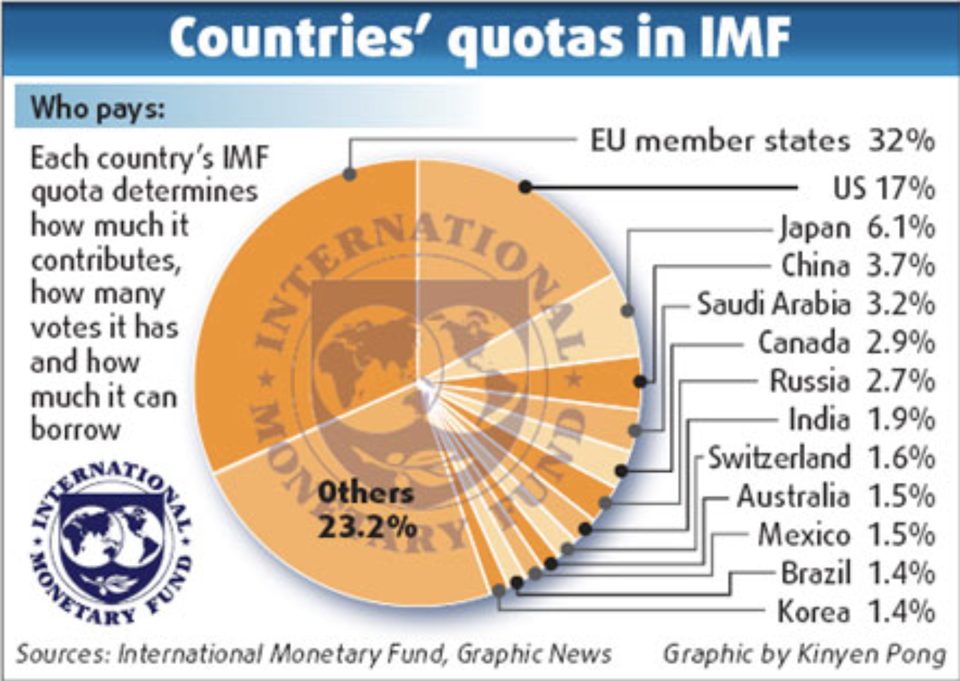
IMF Funding
Source: China Daily, 2009
Notes:
https://www.chinadaily.com.cn/bizchina/2009-05/14/content_7775618.htm

Slide 41
IMF Funding
IMF Quotas and Voting
  Countries’ voting shares are similar to their quotas
  Today, US quota share is 17.43% and its voting share is 16.50%
    That gives US a veto on all major decisions
  These quotas
    Have not been increased since 2010, limiting the IMF’s ability to operate
      It has expanded borrowing to compensate
    They were to be discussed for revision at annual meeting
      October 9-15, 2023
Notes:
https://www.ft.com/content/ab44dccf-e613-485d-a901-2b19badc9705

Slide 42
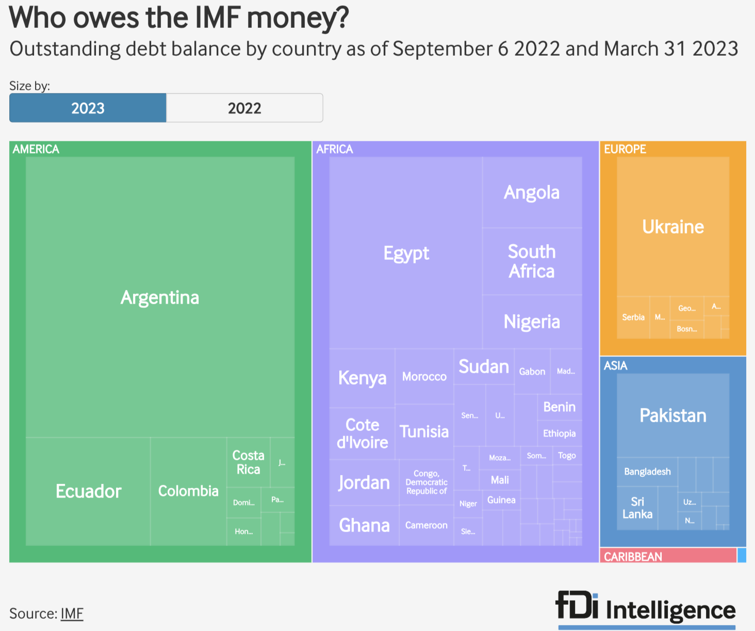
IMF
Notes:
https://www.fdiintelligence.com/content/news/the-imfs-top-10-biggest-debtors-81405

Slide 43

World Bank

Slide 44
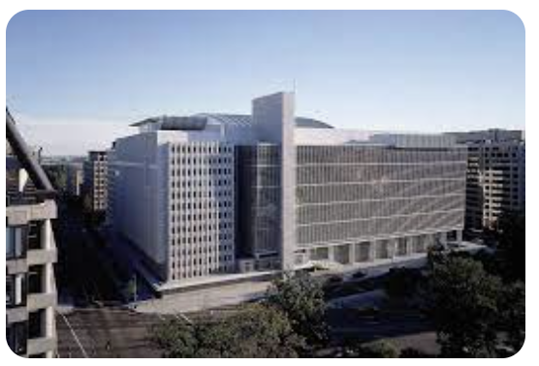
World Bank
World Bank Group
  Created at Bretton Woods 1944
  Headquarters Washington, DC
  Original purpose
    To assist war-destroyed countries to recover from WWII
  Current purpose
    To assist developing countries with
      Loans
      Policy advice
      Assistance

Slide 45
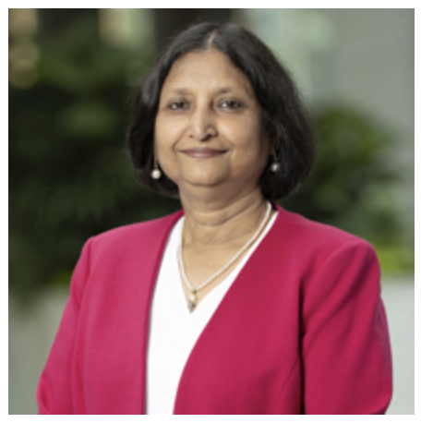
World Bank
Managing Director: Anshula Kant
  Former CFO of State Bank of India

Slide 46
World Bank
World Bank Institutions:
  International Bank for Reconstruction and Development
  International Development Association
  International Finance Corporation
  Multilateral Investment Guarantee Agency
  International Centre for Settlement of Investment Disputes

Slide 47
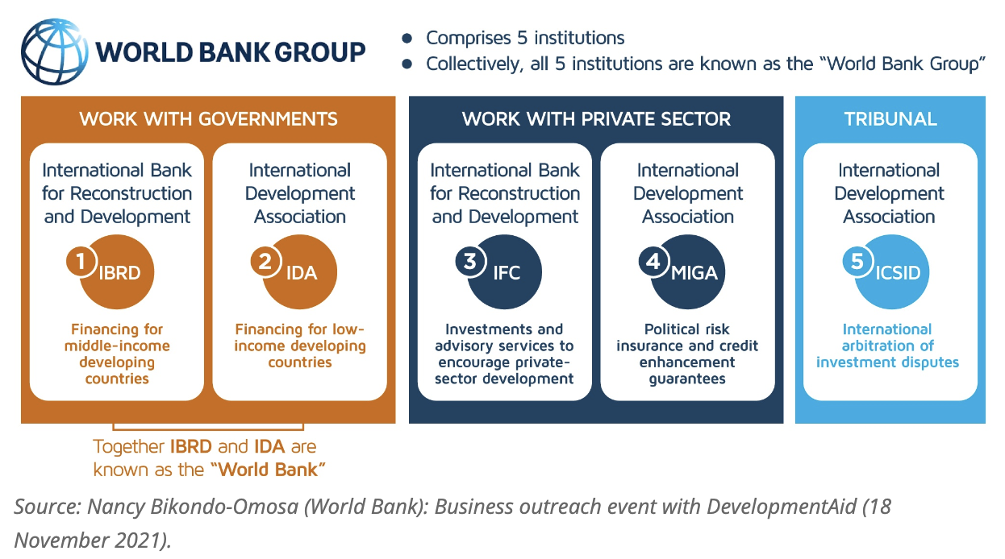
World Bank
Est. 1945
Est. 1960
Est. 1956
Est. 1988
Est. 1966
Notes:
https://www.developmentaid.org/news-stream/post/124249/doing-business-with-the-world-bank-2
http://www.globalislander.com/2012/10/the-world-bank-group.html

Slide 48
World Bank Lending
World Bank borrows all the money that it lends
  It borrows from all over the world at very low interest rates
It lends
  To middle-income countries at rates below commercial banks
  To the poorest countries at no interest
Borrowers must
  Cover part of any project from other sources (own funds or commercial loans)
  Pay back their loans
Notes:
https://www.worldbank.org/en/news/feature/2012/07/26/getting_to_know_theworldbank

Slide 49
World Bank Lending
Projects help countries to
  Supply safe drinking water
  Build schools and train teachers
  Increase agricultural productivity
  Manage forests and other natural resources
  Build and maintain roads, railways, and ports
  Extend telecommunications networks
  Generate and distribute energy
  Expand health care
  Modernize
Notes:
https://www.worldbank.org/en/news/feature/2012/07/26/getting_to_know_theworldbank

Slide 50
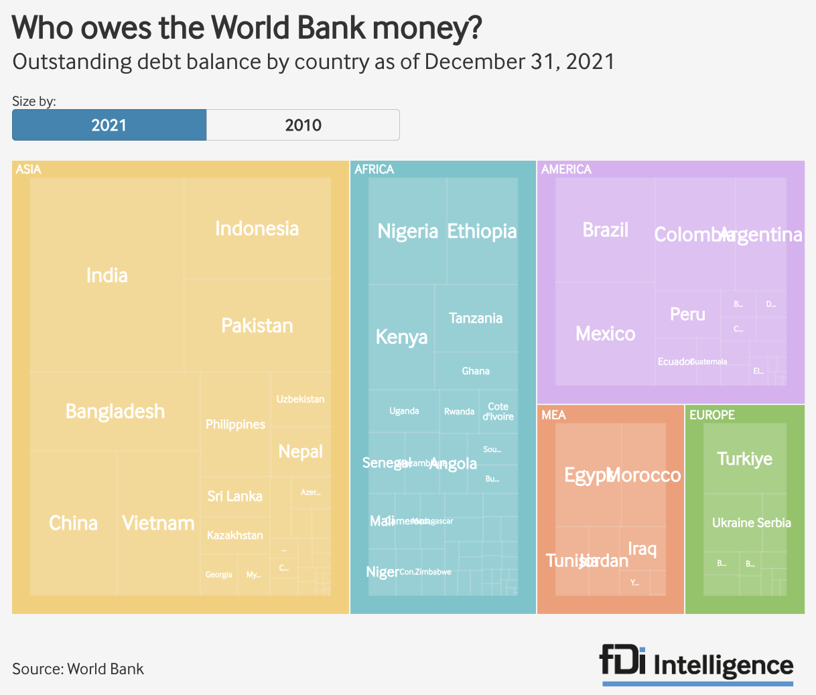
World Bank
Notes:
https://www.fdiintelligence.com/content/data-trends/the-world-banks-top-10-biggest-debtors-82044

Slide 51

World Trade Organization

Slide 52
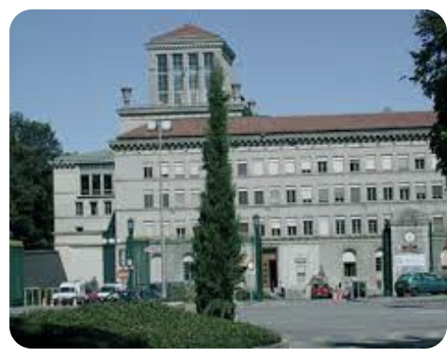
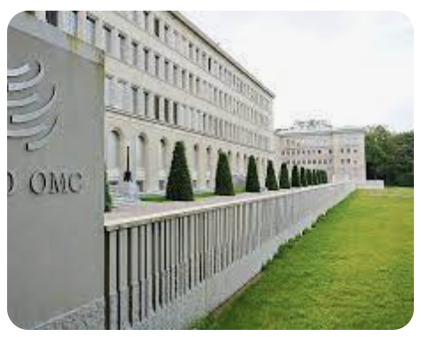
WTO
World Trade Organization
  Created 1995 by Uruguay Round Ministerial of the GATT
  Headquarters in Geneva, Switzerland
  Purposes
    Operate a system of rules on international trade policies
    Serve as forum for negotiating trade agreements
    Settle trade disputes between countries
Notes:
https://www.wto.org/english/thewto_e/thewto_e.htm

Slide 53
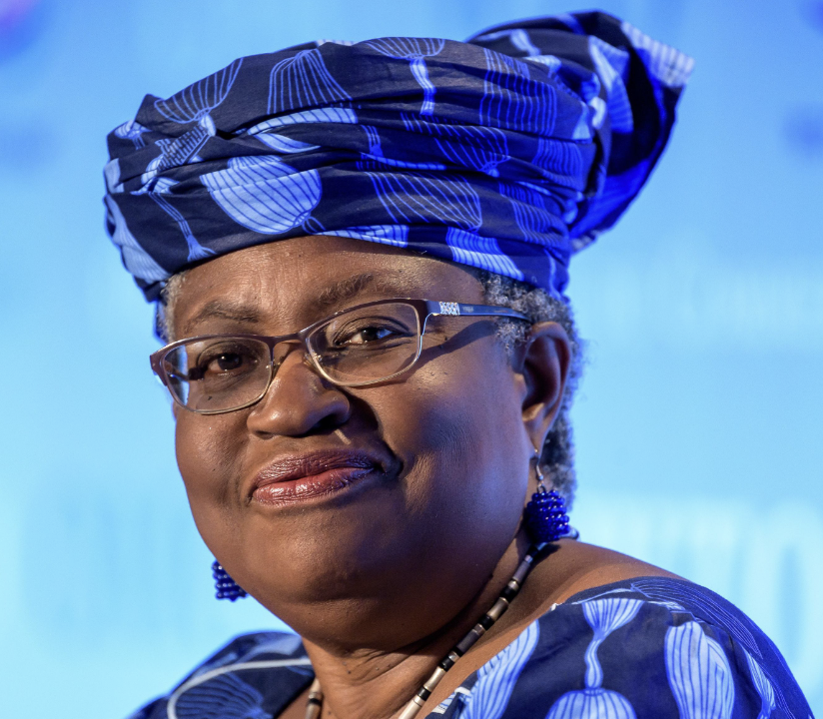
WTO
Director-General: Ngozi Okonjo-Iweala
  Nigerian-American economist
  Previously Minister of Finance, Nigeria

Slide 54
WTO
Three parts:
  GATT = General Agreement on Tariffs and Trade
  GATS = General Agreement on Trade in Services
  TRIPs = Trade-Related Aspects of Intellectual Property Rights
Functions (see below)

Slide 55
WTO Functions
Functional Outline of the World Trade Organization
Communication
Constraints
Exceptions
Dispute Settlement

Slide 56
WTO Functions
Communication | Ministerials
 | Negotiating Rounds
 | Working Groups
 | Trade Policy Review Mechanism
 | Councils and Committees
Trade Ministers (USTR, etc.) Meet “Every” Two Years
Tariff Reductions; Changes in Rules

Slide 57
WTO Functions
National Treatment for Service Firms (only in some industries)
Constraints | Tariff Bindings
 | Customs Valuation
 | Product Regulations
 | Quantitative Restrictions
 | Subsidies
 | Foreign Direct Investment (TRIMS)
 | Services (GATS)
 | Intellectual Property (TRIPs)
Countries negotiate and commit to maximum tariffs
Enforce Patents, Copyrights, Trademarks
57

Slide 58
WTO Functions
Most commonly used
Exceptions | Anti-Dumping
 | Countervailing Duties
 | Safeguards
 | Balance of Payments Protection
 | Preferential Trade Agreements
Permitted; not required
Allows NAFTA, EU, etc.

Slide 59
WTO Functions
Standing Committee that reviews most cases
Dispute Settlement | Consultation
 | Panel Recommendation
 | Appellate Body
 | Remedy | Implementation
 |  | Compensation
 |  | Retaliation
3-person Panel Decides Case
The Ultimate Remedy: Permit Tariffs

Slide 60
WTO and the United States
Dispute Settlement Body (DSB)
  Lacks a quorum to process appeals since Dec 11, 2019
  Trump blocked all new appointments
  Biden has not changed this
Without DSB no case can finish if it is appealed (which all are)
Other countries formed an alternative mechanism, not including US

Slide 61
WTO Disputes
Trump and the WTO
  Oct 25, 2017, on Fox interview with Lou Dobbs:
    “The WTO, World Trade Organization, was set up for the benefit for everybody but us.”
    “we lose the lawsuits, almost all of the lawsuits … within the WTO”
  In fact, like other countries, US
    Wins most of the cases it brings
    Loses most the cases brought against it
  Since 1995, in all cases, complainant has won 90%
    As complainant, US has won 91%
    As respondent, US has lost 89%

Slide 62
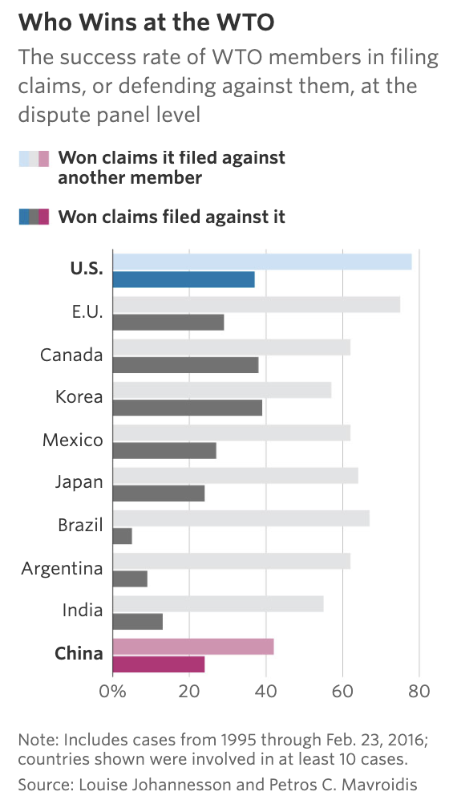
WTO Disputes
Source: WSJ, 2017
Notes:
Schlesinger, Jacob M., “How China Swallowed the WTO,” Wall Street Journal, November 2, 2017.
https://www.wsj.com/articles/how-china-swallowed-the-wto-1509551308

Slide 63
WTO and the United States
National-Security Tariffs (on steel, aluminum)
    Cases brought by EU and many others
    EU, Canada, & Mexico cases settled by negotiation
    Other cases status: panel composed
  How did WTO rule?
    Panel report in December 2022 found against the US
      Said action was not “in time of war or other international emergency”
    US appealed (but has blocked the Appellate Body)
  WTO provision:
    Article XXI: “[n]othing in this Agreement shall be construed . . . to prevent any contracting party from taking any action which it considers necessary for the protection of its essential security interests . . . taken in time of war or other emergency in international relations[.]”

Slide 64
WTO and the United States
Trade war with China
  Tariffs levied under US “Section 301” not consistent with GATT/WTO
  WTO panel ruled against US Sep 15, 2020
    Panel: “Trump’s tariffs violated several global rules” (NYT)
  US appealed but case cannot be completed
  Even without that, would WTO permission for China to levy tariffs be meaningful?

Slide 65
Other Institutions
Other Institutions
  OECD
  G-7, G-20
  UN Organizations
    UNCTAD
    ILO
    WIPO
    Regional Commissions for Economic and Social Development
  International Development Banks

Slide 66

OECD

Slide 67
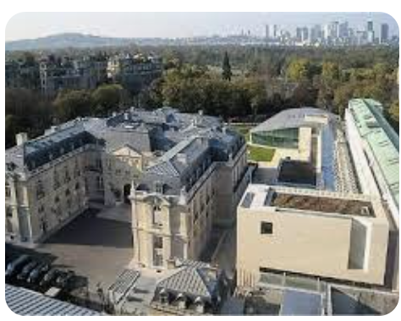
OECD
OECD = Organization for Economic
Cooperation and Development
  38 member countries
  Headquarters Paris, FR
  Economist calls it a “rich-country think tank”
  “provides governments a setting in which to discuss, develop and perfect economic and social policy”
  Most recently, OECD agreed on a “global treaty” to tax digital technology giants in the countries where they do business
    143 countries took in the negotiations
    It still needs to be signed and ratified by “enough countries”.
    Some important ones (e.g., US) may not
Notes:
https://www.ft.com/content/2219e65d-19a6-4da3-a5d0-192300775e64

Slide 68
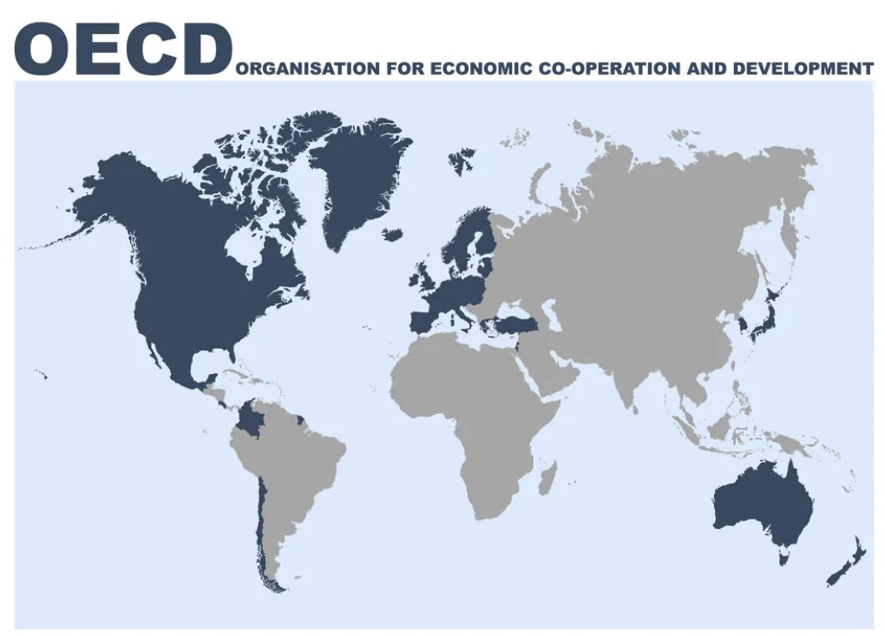
OECD

Slide 69

G-20

Slide 70
G-20
G-7: US, Canada, Japan, Britain, France, Germany, and Italy (plus the EU)
  Began annual meetings of heads of state in 1976
G-20: G7 plus 13 others, both major developed and developing countries
  Founded 1999 with only finance ministers
  Began head-of-state meetings after financial crisis of 2008
    “Summit on Financial Markets and the World Economy”
  Today, G7 deals more with politics, G20 with economics
G-20 met in India September 9-10, 2023
  Launched India-Middle East-Europe Economic Corridor

Slide 71
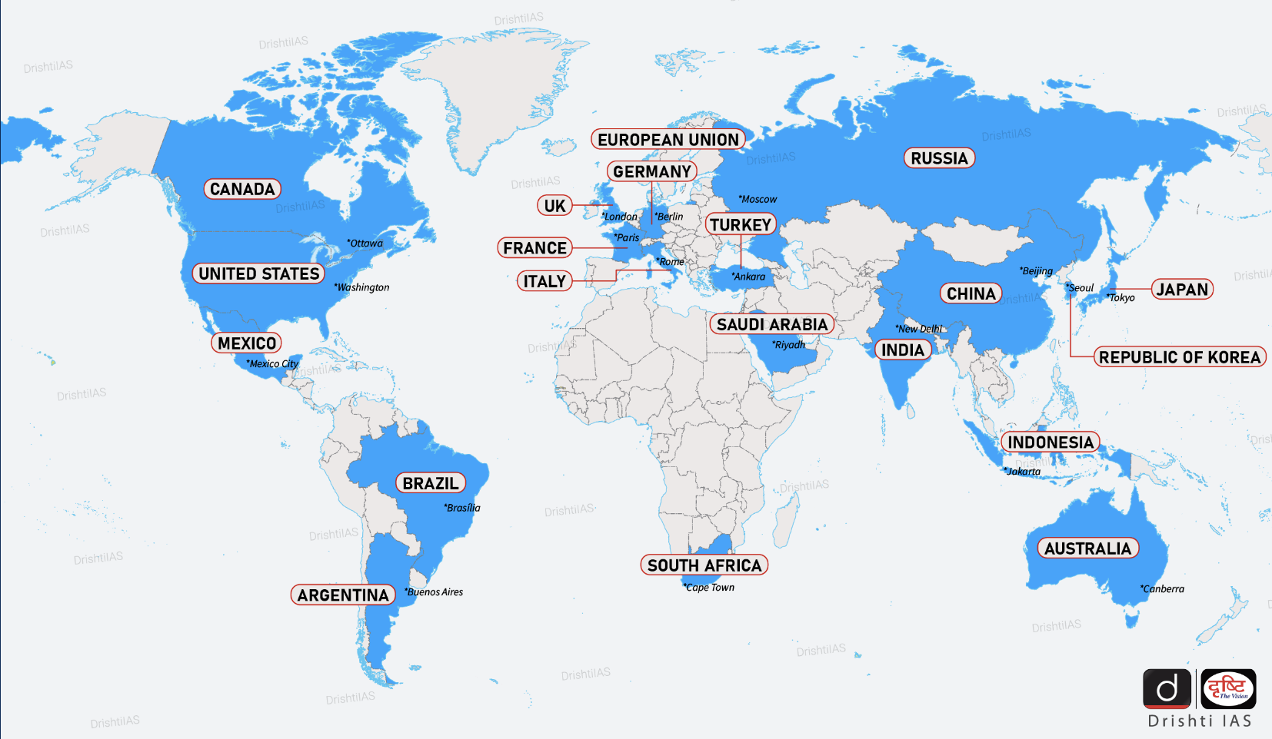
G-20
Notes:
https://www.drishtiias.com/daily-updates/daily-news-analysis/g20-map

Slide 72

UNCTAD

Slide 73
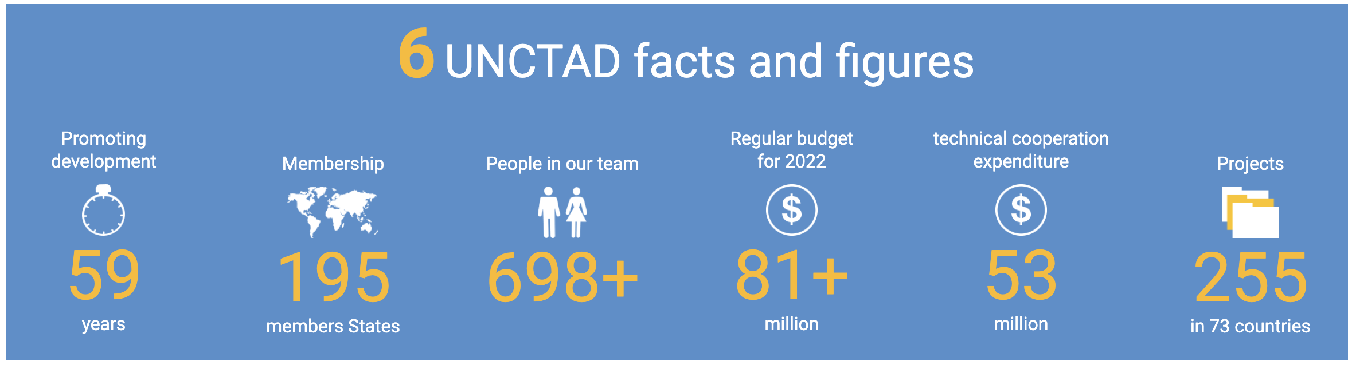
UNCTAD
UNCTAD = United Nations Conference on Trade and Development
  Supports “developing countries to access the benefits of a globalized economy more fairly and effectively.”
> 193 members of UN
Notes:
https://unctad.org/about

Slide 74

ILO

Slide 75
ILO
ILO = International Labor Organization
  Created 1919 by Treaty of Versailles
  Tripartite: governments, employers and workers
  Sets labor standards, develops policies, and devises programs promoting decent work
  Has no power to enforce, but only to shame

Slide 76
ILO
Fundamental ILO Conventions
Freedom of Association
  Right to Organize (157)
  Right to Collective Bargaining (168)
Abolition of Forced Labor
  Forced Labor (180)
  Abolition of Forced Labor (178*)
Equality
  Discrimination (174)
  Equal Remuneration (175)
Elimination of Child Labor
  Minimum Age (175)
  Worst Forms of Child Labor (187*)
(# countries ratifying)
* USA ratified

Slide 77

WIPO

Slide 78
WIPO
WIPO = World Intellectual Property Organization
  Global forum for intellectual property policy, services, information and cooperation.
  IP includes
    Patents
    Copyrights
    Trademarks
    Trade secrets
Has no power to enforce

Slide 79

Regional Commissions for Economic and Social Development

Slide 80
Regional Commissions for Economic and Social Development
Economic Commission for Africa (ECA), Addis Ababa, Ethiopia
Economic Commission for Europe (ECE), Geneva, Switzerland
Economic Commission for Latin America and the Caribbean (ECLAC), Santiago, Chile
Economic and Social Commission for Asia and the Pacific (ESCAP), Bangkok, Thailand
Economic and Social Commission for Western Asia (ESCWA), Beirut, Lebanon

Slide 81
Regional Commissions for Economic and Social Development
What Regional Commissions for Economic and Social Development do:
  They “promote economic development and cooperation in their respective regions”
  They normally meet once a year
  They enable member States to maintain contact with one another and with the Secretariat between sessions of the General Assembly, to which they submit their proposals and convey their concerns.
  Each maintains offices and staff in their region to undertake programs of work

Slide 82

International Development Banks
…

Slide 83
International Development Banks
There is a long list of International (or Multilateral) Development Banks. The largest are
  The African Development Bank Group
  The Asian Development Bank
  The European Bank for Reconstruction and Development
  The Inter-American Development Bank
  The World Bank Group
My Glossary lists 14 more and is surely incomplete

Slide 84
International Development Banks
Purpose: “to provide medium- and long-term capital for productive investment, often accompanied by technical assistance, in poor countries.”
They “may be publicly or privately owned and operated, but governments frequently make substantial contributions to the private ones.”
Concerns:
  Bad investments
  Imposing policies that destabilize countries
  Moral hazard: encouraging irresponsible policies
Source: Britannica. Money
Notes:
https://www.britannica.com/money/development-bank

Slide 85
Economic Groupings of Countries
Free Trade Agreements and Customs Unions
  European Union
  USMCA
  CPTPP
  RCEP
  MERCOSUR
Other
  G-20 Developing
  Cairns Group

Slide 86
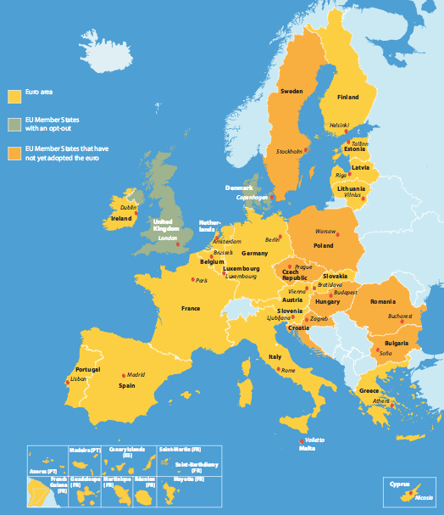
Economic Groupings of Countries
European Union
Notes:
http://europa.eu/european-union/about-eu/money/euro_en

Slide 87
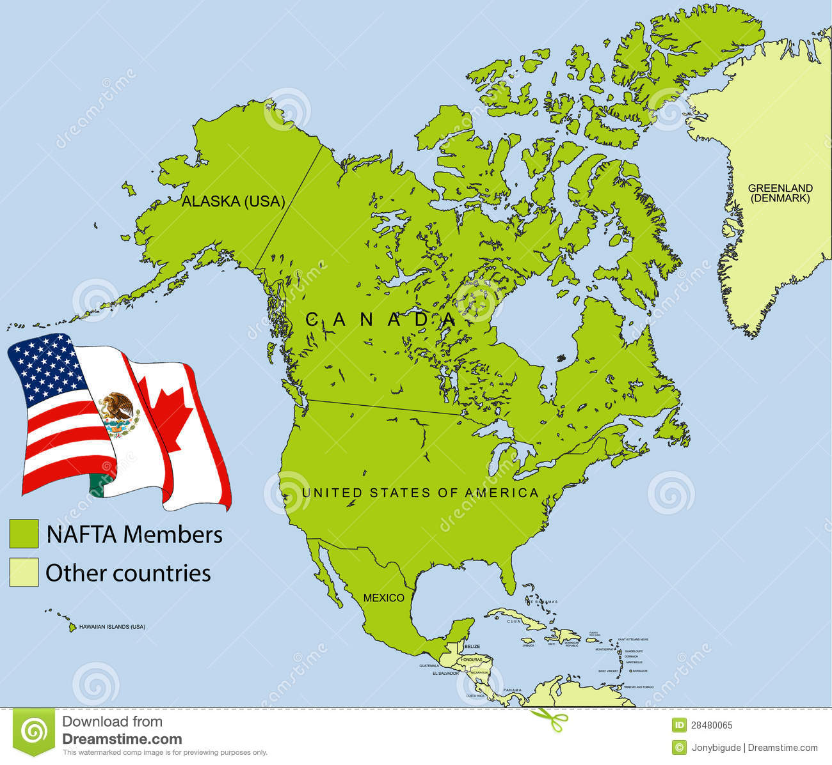
Economic Groupings of Countries
NAFTA (now USMCA)
Notes:
https://maproom.net/shop/eu-map/

Slide 88
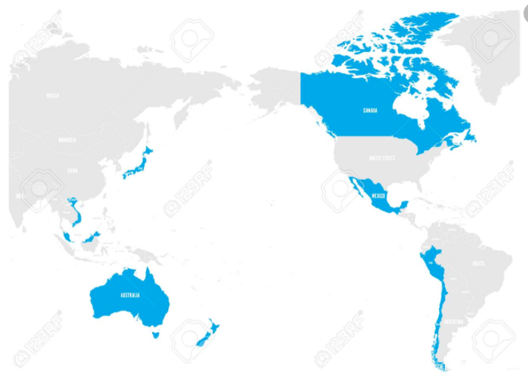
Economic Groupings of Countries
CPTPP
=
Trans-Pacific Partnership
minus US
Notes:
https://maproom.net/shop/eu-map/

Slide 89
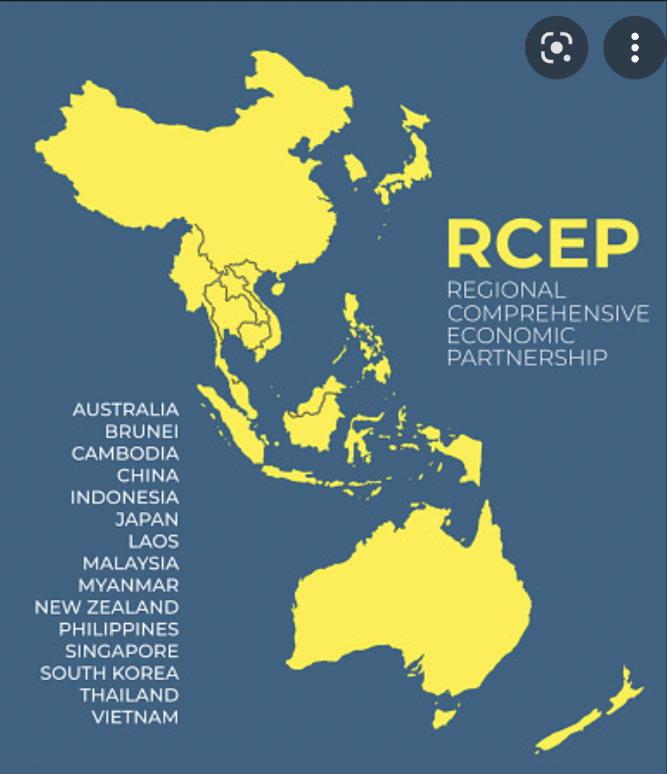
Economic Groupings of Countries
RCEP
=
Regional Comprehensive Economic Partnership
Notes:
https://maproom.net/shop/eu-map/

Slide 90
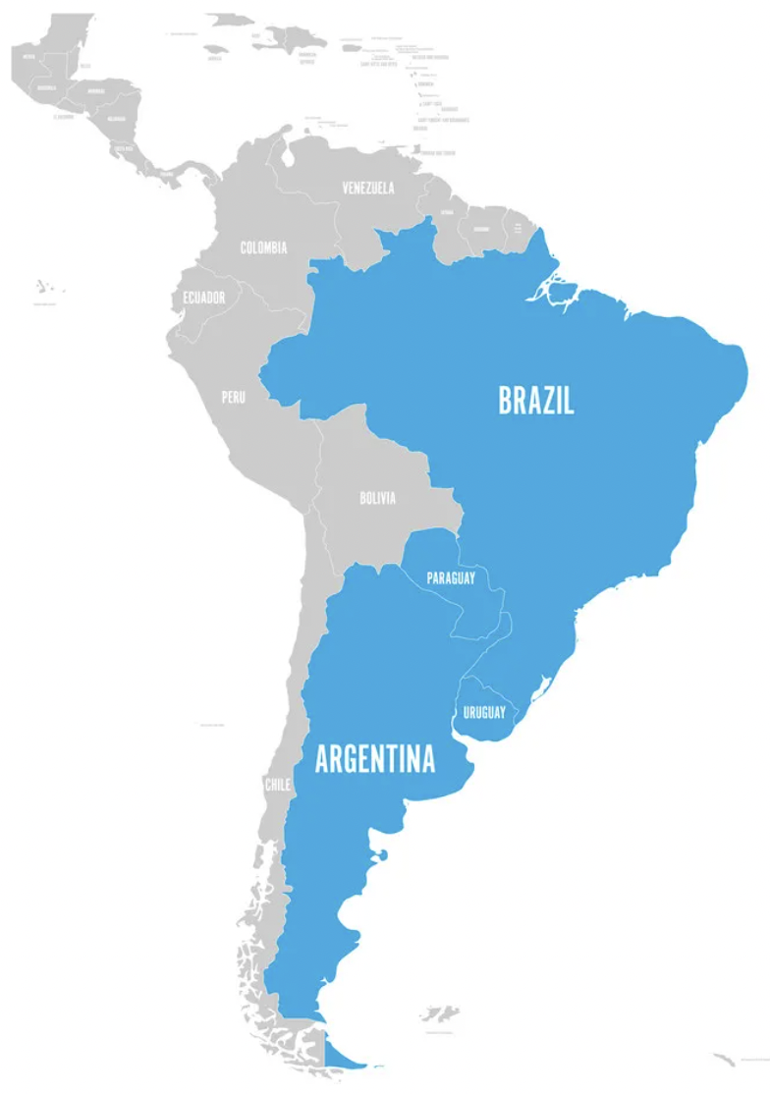
Economic Groupings of Countries
MERCOSUR
Notes:
https://maproom.net/shop/eu-map/

Slide 91
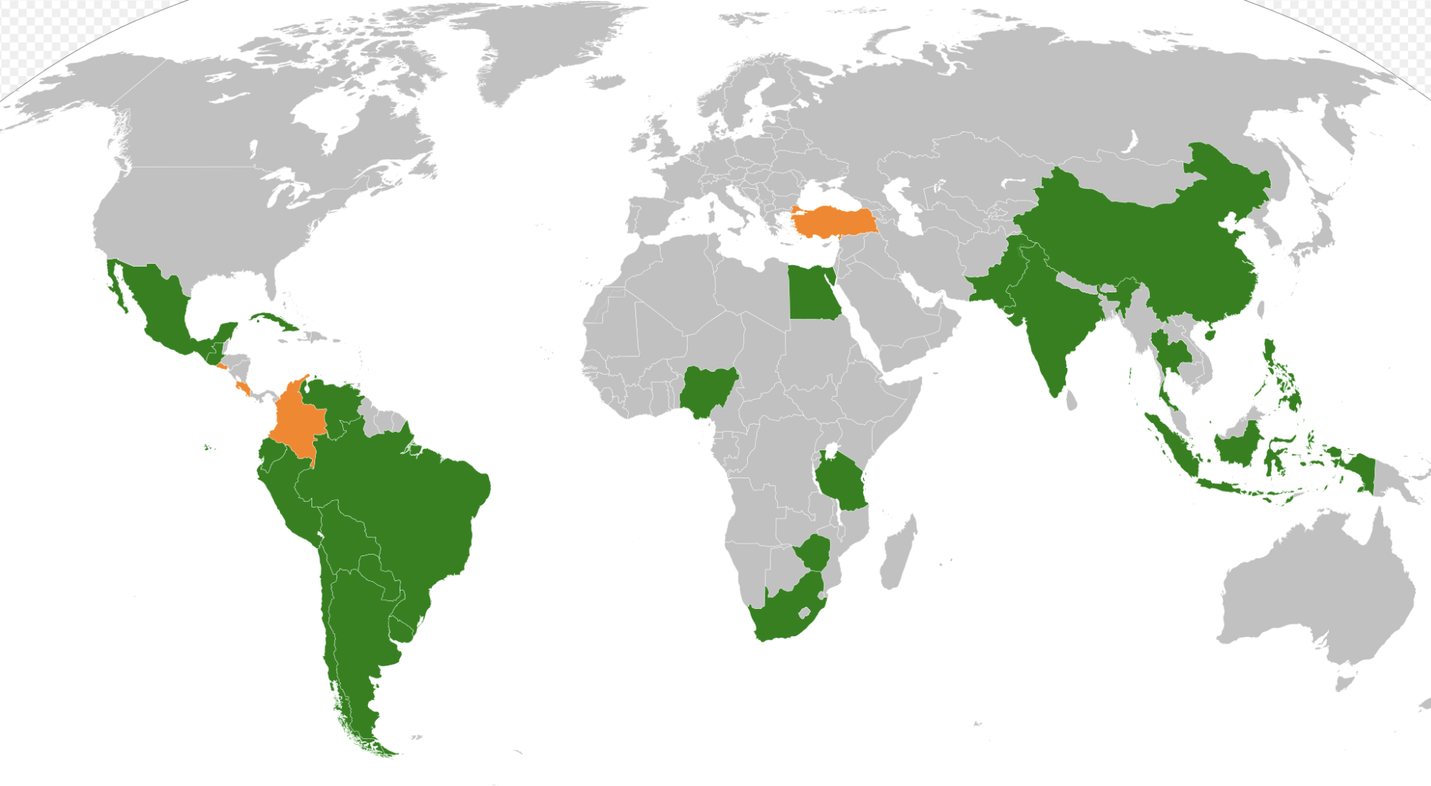

Economic Groupings of Countries
G20 Developing Countries
Notes:
https://maproom.net/shop/eu-map/

Slide 92
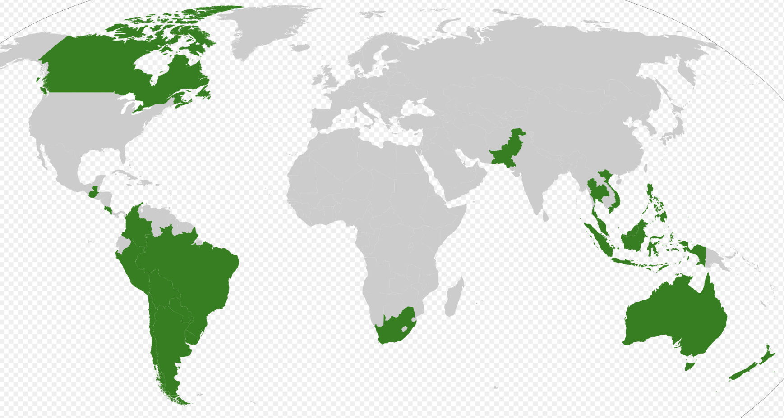

Economic Groupings of Countries
Cairns Group
Notes:
https://maproom.net/shop/eu-map/

Slide 93
Next Week
Economics of Immigration
Roger White
Whittier College

Slide 94
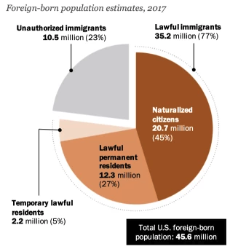
Immigrant Population in 2017
Categories of the total number
of immigrants in the United States.
https://www.pewresearch.org/fact-tank/2019/07/12/how-pew-research-center-counts-unauthorized-immigrants-in-us/

Slide 95
Thank you!
Any Questions?
www.NEEDEcon.org
Alan Deardorff
alandear@umich.edu
Contact NEED: info@NEEDEcon.org
Submit a testimonial: www.NEEDEcon.org/testimonials.php
Become a Friend of NEED: www.NEEDEcon.org/friend.php

